Slide 1
Figures – Chapter 14

Slide 2
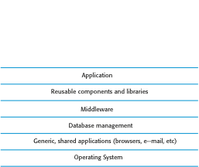
Figure 14.1 System layers where security may be compromised

Slide 3
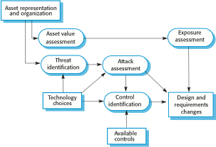
Figure 14.2 Life-cycle risk analysis

Slide 4
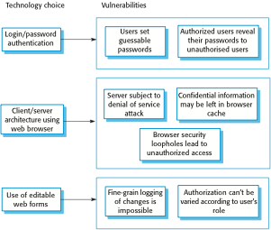
Figure 14.3 Vulnerabilities associated with technology choices

Slide 5
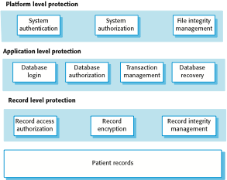
Figure 14.4 A layered protection architecture

Slide 6
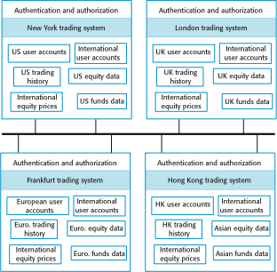
Figure 14.5 Distributed assets in an equity trading system

Slide 7
Figure 14.6 Design guidelines for secure systems engineering
Security guidelines
Base security decisions on an explicit security policy
Avoid a single point of failure
Fail securely
Balance security and usability
Log user actions
Use redundancy and diversity to reduce risk
Validate all inputs
Compartmentalize your assets
Design for deployment
Design for recoverability

Slide 8

Figure 14.7 Software deployment

Slide 9
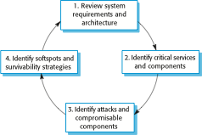
Figure 14.8 Stages in survivability analysis

Slide 10
Figure 14.9 Survivability analysis in an equity trading system
Attack | Resistance | Recognition | Recovery
Unauthorized user places malicious orders | Require a dealing password that is different from the login password to place orders. | Send copy of order by e-mail to authorized user with contact phone number (so that they can detect malicious orders). Maintain user’s order history and check for unusual trading patterns. | Provide mechanism to automatically ‘undo’ trades and restore user accounts. Refund users for losses that are due to malicious trading. Insure against consequential losses.
Corruption of transactions database | Require privileged users to be authorized using a stronger authentication mechanism, such as digital certificates. | Maintain read-only copies of transactions for an office on an international server. Periodically compare transactions to check for corruption. Maintain cryptographic checksum with all transaction records to detect corruption. | Recover database from backup copies. Provide a mechanism to replay trades from a specified time to re-create the transactions database.

